Slide 1
NETWORKS,PROTOCOLS AND SECURITY (NPS)
COURSE CODE: 22EC2210R
CO1_ PHYSICAL LAYER
SESSION NO: 6
SWITCHING
MODEMS
TRUNKS and MULTIPLEXING

Slide 2
SWITCHING
Switching technique is transferring the information from one computer network to another network is
Switching in a computer network is achieved by using switches.
A switch is a small hardware device which is used to join multiple computers together with one local area network (LAN).
Switches are devices capable of creating temporary connections between two or more devices linked to the switch.
Switches are used to forward the packets based on MAC addresses.
A Switch is used to transfer the data only to the device that has been addressed. It verifies the destination address to route the packet appropriately.
It is operated in full duplex mode.
It does not broadcast the message as it works with limited bandwidth.

Slide 3
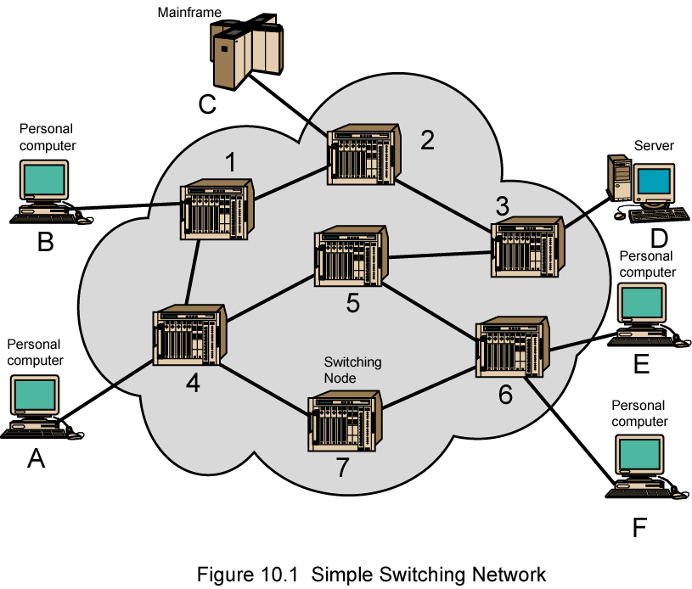
Simple Switched Network

Slide 4
Advantages :
Switch increases the bandwidth of the network.
It reduces the workload on individual PCs as it sends the information to only that device which has been addressed.
It increases the overall performance of the network by reducing the traffic on the network.
There will be less frame collision as switch creates the collision domain for each connection. Disadvantages :
A Switch is more expensive than network bridges.
A Switch cannot determine the network connectivity issues easily.
Proper designing and configuration of the switch are required to handle multicast packets.

Slide 5
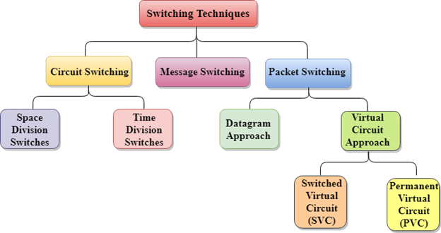
Classification Of Switching Techniques

Slide 6
Circuit Switching
Circuit switching is a switching technique that establishes a dedicated path between sender and receiver.
Once the connection is established then the dedicated path will remain to exist until the connection is terminated.
Circuit switching in a network operates in a similar way as the public telephone networks.
when any user wants to send the data, voice, video, a request signal is sent to the receiver then the receiver sends back the acknowledgment to ensure the availability of the dedicated path.
After receiving the acknowledgment, dedicated path transfers the data.
It is used for voice transmission.
Fixed data can be transferred at a time in circuit switching technology.

Slide 7
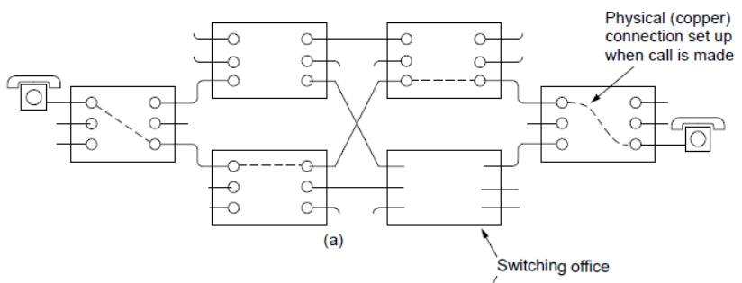
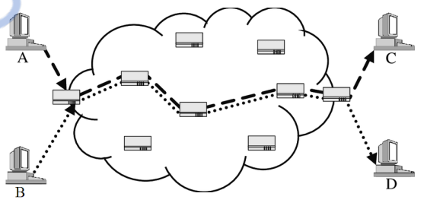

Slide 8
Phases in Circuit Switching
Communication through circuit switching has 3 phases:
Connection Setup / Establishment - In this phase, a dedicated circuit is established from the source to the destination through a number of intermediate switching centers. The sender and receiver transmits communication signals to request and acknowledge establishment of circuits.
Data transfer - Once the circuit has been established, data and voice are transferred from the source to the destination. The dedicated connection remains as long as the end parties communicate.
Connection teardown / Termination - When data transfer is complete, the connection is relinquished. The disconnection is initiated by any one of the user. Disconnection involves removal of all intermediate links from the sender to the receiver

Slide 9
Advantages
It is suitable for long continuous transmission, since a continuous transmission route is established, that remains throughout the conversation.
No intermediate delays are found once the circuit is established. So, they are suitable for real time communication of both voice and data transmission.
Disadvantages Circuit switching establishes a dedicated connection between the end parties. This dedicated connection cannot be used for transmitting any other data, even if the data load is very low. Bandwidth requirement is high even in cases of low data volume. There is underutilization of system resources. Once resources are allocated to a particular connection, they cannot be used for other connections. Time required to establish connection may be high.
It is more expensive

Slide 10
PACKET SWITCHING
The packet switching is a switching technique in which the message is sent in one go, but it is divided into smaller pieces, and they are sent individually.
The message splits into smaller pieces known as packets and packets are given a unique number to identify their order at the receiving end.
Every packet contains some information in its headers such as source address, destination address and sequence number.
Packets will travel across the network, taking the shortest path as possible.
All the packets are reassembled at the receiving end in correct order.
If any packet is missing or corrupted, then the message will be sent to resend the message.
If the correct order of the packets is reached, then the acknowledgment message will be sent.

Slide 11
Advantages
Cost-effective: In packet switching technique, switching devices do not require massive secondary storage to store the packets, so cost is minimized to some extent.
Reliable: If any node is busy, then the packets can be rerouted. This ensures that the Packet Switching technique provides reliable communication.
Efficient: Packet Switching is an efficient technique. It does not require any established path prior to the transmission, and many users can use the same communication channel simultaneously, hence makes use of available bandwidth very efficiently.
Disadvantages :
Packet Switching cannot be implemented in those applications that require low delay and high-quality services.
The protocols used in a packet switching technique are very complex and requires high implementation cost.
If the network is overloaded or corrupted, then it requires retransmission of lost packets.

Slide 12
Approaches of Packet Switching
1) Datagram Packet Switching (Connectionless Switching)
2) Virtual Circuit Switching
Datagram Packet Switching
Each packet known as a datagram that contains the information about the destination.
Switch uses this information to forward the packet to the correct destination.
The packets are reassembled at the receiving end in correct order.
Since the path is not fixed the Intermediate nodes take the routing decisions to forward the packets.
There are no setup or teardown phases.
Each packet is treated the same by a switch regardless of its source or destination.

Slide 13
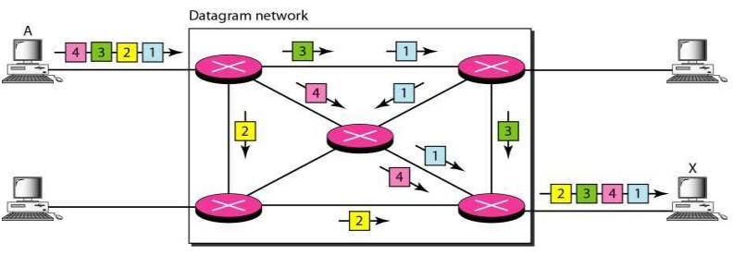
In this example, all four packets (or datagrams) belong to the same message, but may travel different paths to reach their destination.

Slide 14
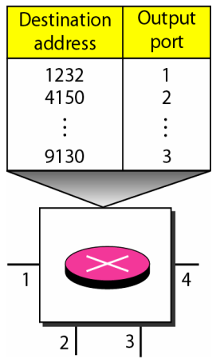
Routing Table
In this type of network, each switch (or packet switch) has a routing table which is based on the destination address. The routing tables are dynamic and are updated periodically. The destination addresses and the corresponding forwarding output ports are recorded in the tables
The packet travels through two switches.
The destination address in the header of a packet in a datagram network remains the same during the entire journey of the packet.
When the switch receives the packet, this destination address is examined;
the routing table is consulted to find the corresponding port through which the packet should be forwarded.

Slide 15
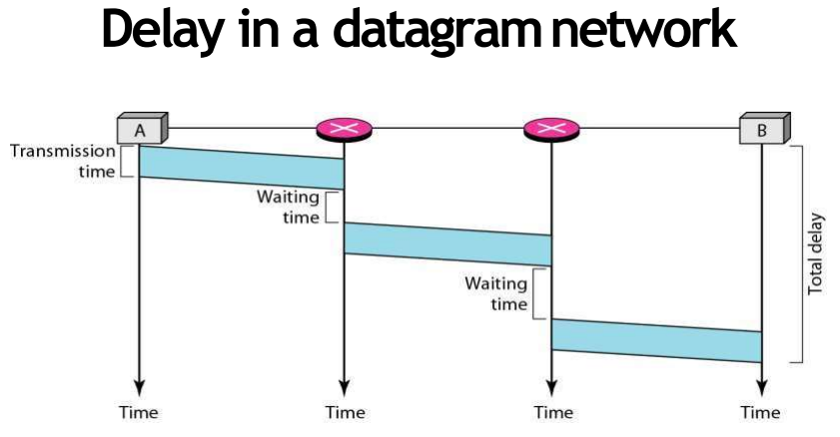
There are three transmission times (3T),three propagation delays (slopes 3t of the lines), and two waiting times (w1 + w2).
We ignore the processing time in each switch.
Total delay = 3T + 3t + w1 + w

Slide 16
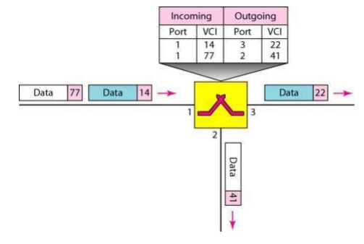
Virtual Circuit Switching
Virtual Circuit Switching is also known as connection-oriented switching.
In the case of Virtual circuit switching, a virtual connection is established before the messages are sent.
Call request and call accept packets are used to establish the connection between sender and receiver.
In this case, the path is fixed for the duration of a logical connection.
.

Slide 17
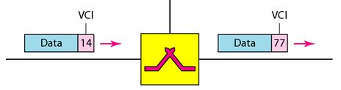
Virtual Circuit Identifier (VCI)
A virtual circuit identifier (VCI) that uniquely identifies the connection at this switch.
A VCI, unlike a global address, is a small number that has only switch scope;
It is used by a frame between two switches.
When a frame arrives at a switch, it has a VCI; when it leaves, it has a different VCI
Local Addressing:
Actually used for data transfer –
A small address used by a frame between two switches

Slide 18
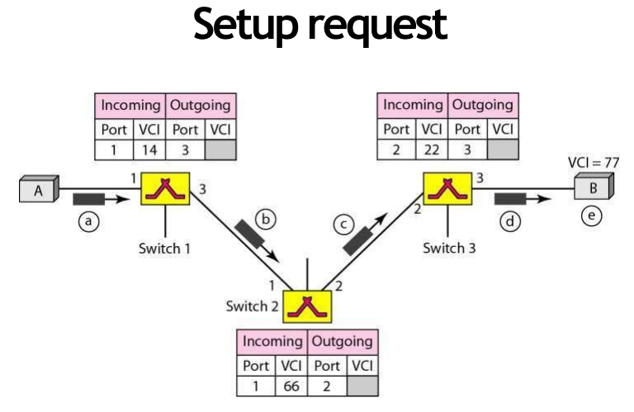
The switch, in the setup phase acts as a packet switch ; it has a routing table used to know the output port number

Slide 19
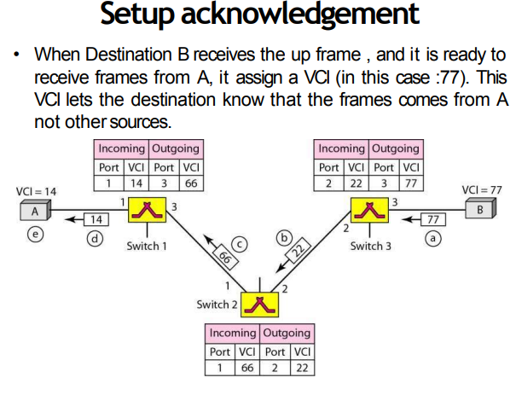

Slide 20
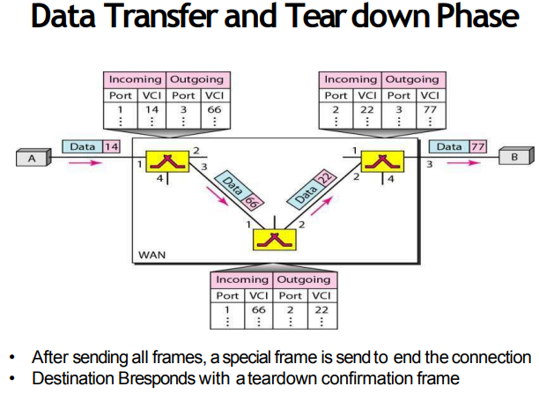

Slide 21
MESSAGE SWITCHING
Message Switching is a switching technique in which a message is transferred as a complete unit and routed through intermediate nodes at which it is stored and forwarded.
In Message Switching technique, there is no establishment of a dedicated path between the sender and receiver.
The destination address is appended to the message. Message Switching provides a dynamic routing as the message is routed through the intermediate nodes based on the information available in the message.
Message switches are programmed in such a way so that they can provide the most efficient routes. o Each and every node stores the entire message and then forward it to the next node. This type of network is known as store and forward network.
Message switching treats each message as an independent entity.

Slide 22
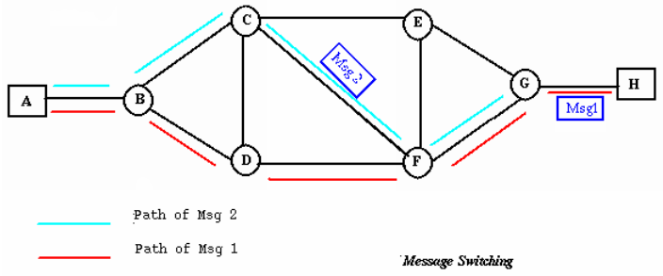
MESSAGE SWITCHING

Slide 23
Advantages:
• Channel efficiency can be greater compared to circuit switched systems, because more devices are sharing the channel.
• Traffic congestion can be reduced, because messages may be temporarily stored in route.
• Message priorities can be established due to store-and-forward technique.
• Message broadcasting can be achieved with the use of broadcast address appended in the message. Message Switching
Disadvantages:
• Message switching is not compatible with interactive applications.
• Store-and-forward devices are expensive, because they must have large disks to hold potentially long messages.

Slide 24
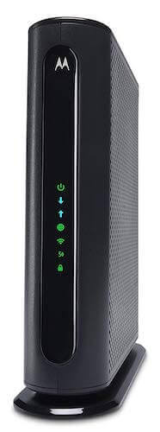
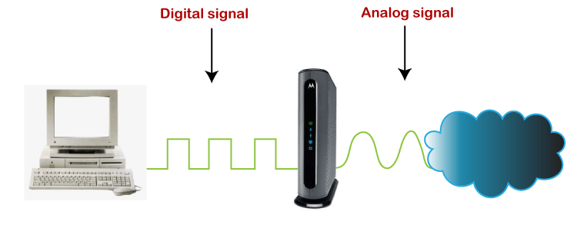
Modem
What is a Modem?
A modem is a device that modulates or demodulates the signal. It maintains a dedicated connection with the ISP to get the internet connection for home or business.
It acts as a bridge between the internet/telephone line and the computer.

Slide 25
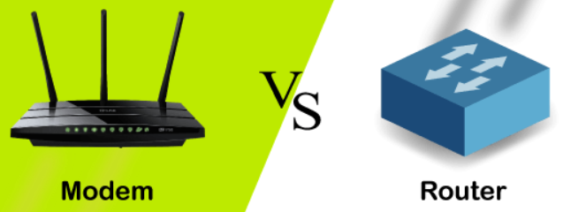
Modem vs. Router
A modem is a box-type device that connects your home/office network directly to the internet.
The router is also a box-type device that enables multiple computer systems (either wired or wireless) to use the internet simultaneously.
Nowadays, both the devices are either integrated or individual and provided by the ISP(INTERNET SERVICE PROVIDER) when we take the new internet plan for our home/office network.
Although most of the time people get confused to identify both the devices, both devices have two different roles on a network.

Slide 26
Features of Modems
The reason to use the modem for an internet connection is that both the internet and the computer take two different signals.
It means that the internet sends the analog signal, but the computer system can only understand the digital signal. So, we need a device that can convert an analog signal to a digital signal and vice versa.
It modulates the incoming analog signal from the internet to digital signal and directs it to the computer, and vice versa.
Modem performs data compression, error correction and controls the flow of information. It speed-up the process of transmission of data by grouping the data and send it in one go.

Slide 27
Types of Modems
According to Transmission Media
------Dial-Up
------Radio
------Cable
------Optical
2)According to Transmission Mode / Synchronization
----Asynchronous
----Synchronous Modems
3) According to Modulation techniques
-------Amplitude shift keying (ASK).
------Frequency shift keying (FSK).
------Phase shift keying (PSK).
----- Differential PSK (DPSK).

Slide 28
4) According to Directional Capacity/Operation Mode
----- Simplex
----- Half Duplex Modems:
----Full Duplex Modems:
5) According to Line Connection
---- Four Wire Modems
----Two-Wire Modems
6) According to Installation
------External
------Internal
------ Integrated Modem
7) According to Data Rate

Slide 29
8) According to Range
------Short Haul
------Voice Grade
------Wide Band
9) According to access the Internet
-----Telephone modem
-----Cable modem
----- Satellite modem
----- Digital Subscriber Line(DSL)
------Dial Up modem

Slide 30
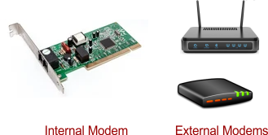

Slide 31
Types of Modems
1. External Modem
The external modem is connected outside the computer system using a serial cable.
The installation is very easy, and it also provides a high data transmission rate.
It is expensive but still used due to its high-speed data transmission in offices, mostly to avoid interruption in network connectivity.
2. Internal Modem
As its name suggests, the internal modem is installed over a PC's motherboard, termed as the internal modem.
It looks similar to an electronic circuit and mounted into an expansion slot of the motherboard.
The installation is complex, and its data transmission speed is also slow; hence it is used for the dedicated computer in homes/ or small spaces.
.

Slide 32
3. Wireless Modem
Wireless modems are connected to the computer systems without any cable, and most people use these modems for their personal use.
These modems use radio frequencies to transmit the data through the air and also provides good transmission speed
4. Dial-up Modem
Dial-up modem establishes the internet connection by connecting the ISP to the computer using the conventional telephone line.
It uses a PSTN facility (Public Switched telephone network) and provides a transmission speed of 56kb/sec.
5. Cable Modem
The cable modem is known as the broadband device as it allows the computer to communicate with ISP over a landline connection.
It is connected with the landline connection using the coaxial cable and with the computer using the ethernet.

Slide 33
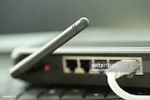
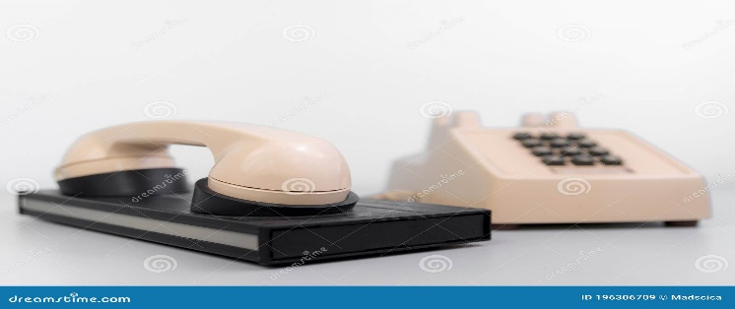
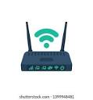

Slide 34
6. DSL Modem
DSL stands for Digital Subscriber line that allows the transmission of data over the telephone line.
It provides a high data transmission speed, hence widely used in offices/homes.
It is used to connect to a computer or router to provide the internet connection through the ethernet port or USB port.
The DSL modems are of two types:
ADSL Modem
SDSL Modem
7. Satellite Modem
Satellite modems are expensive modems and do not require any telephone connection for the internet.
It uses satellite technology to send or receive the data.
The speed of the modem is comparatively slower than DSL or cable Modem.

Slide 35
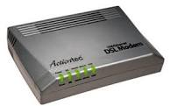


Slide 36
8. Half-duplex Modem
As the name suggests, it allows transmitting the data in one direction only at a time.
It means if it is receiving the signal from one end, at that time, it will stop receiving the signal at another end. Once the transmission of one end is completed, then only the other end can transmit the data.
9. Full Duplex Modem
The full-duplex modems can transmit the data from both ends at the same time.
It means it can receive the data from one end and the other end simultaneously without any interruption.
10. Four-Wire Modem
It splits the pair of wires for incoming and outgoing data carriers.
With this split, it can transmit the same frequency on both ends.
11. Two-Wire Modem
It uses a pair of wires hence called two-wire modems. Only these two wires are used for incoming and outgoing carriers.

Slide 37
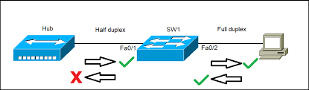

Slide 38
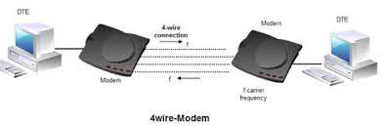

Slide 39
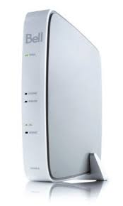

Slide 40
12. ISDN Modem
It uses the integrated services digital network (ISDN) standard and can transmit data over either analog phone lines or digital phone lines.
ISDN speeds range from 64 Kbps to 128 Kbps. An ISDN variant, broadband ISDN, transfers data only fiber optic telephone lines.
13. Fibre Optic Modem
A fiber Optic Modem (FOM) acts as a connecting interface between an electronic device and an internet network.
These modems are different than regular DSL modems because the signal transmission is not via copper cables.
It uses a fiber optic cable network to transmit signals. It transforms electronic communication signals via a fiber-optic network.

Slide 41
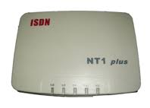
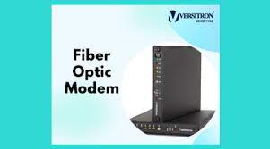

Slide 42
Advantages of Modem
The modem enables us to use the internet connection to connect with the entire world.
Speed is dependent on the cost of the modem.
Disadvantages of Modem
Slow Speeds: Dial-up modems, are very slow and cannot transmit data at high speeds.
Limited Range: Wireless modems, have a limited range and may not be able to transmit data over long distances.
Security Concerns: Modems may be vulnerable to security threats such as hacking and malware attacks
Applications of Modems
1. Data transfer: Dial modems provide secure connections for smoothly transferring the data. These come along with the redial functionality in case a call is dropped.
2. Reliable backup: Modems act as a backup in the absence of stable broadband or server connection
3. Remote management: These networking devices can be installed at remote or sensitive locations.

Slide 43
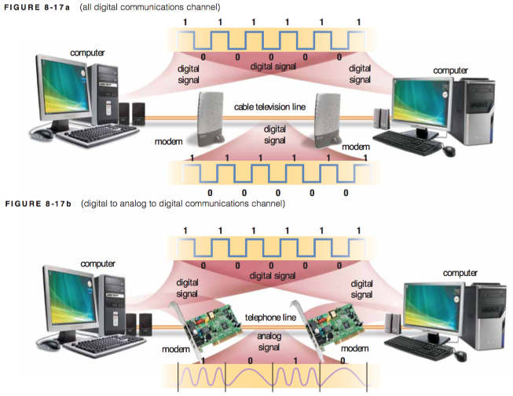

Slide 44
TRUNK
A trunk, is a line or link constructed to handle many signals simultaneously, and to connect major switching centers or nodes in a communication system.
The data transmitted by trunks can be voice, data, computer programs, images, video or control signals.
A trunk consists of many wires or cables to maximise the available bandwidth and the number of channels, or it can also be a wireless link.
Trunks are large-bandwidth communication channels built up locally or through the Internet.
Trunks are used to form networks, and to interconnect LANs to form WANs or VLANs (virtual LANs).
They carry digital information, and they have very high bandwidth.

Slide 45
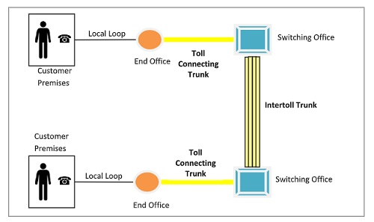
Types of Trunks
Two types of trunks used in Telephone Networks
1)Toll connecting Trunk − Lines that connect end offices with toll offices. Fiber optic cables are used here. 2) Intertoll Trunk − Very high bandwidth channels that connect either two toll offices via intermediate switching offices. Fiber optic cables and microwaves are used here.

Slide 46
TRUNKING
The usage and management of trunks is known as trunking.
Trunking reduces the number of required physical paths (actually, the number of cables and wires) to the minimum.
Trunking is the best solution for companies that needs to manage several phone lines simultaneously.
If a company intends to build up an Internet-based communication system, SIP trunking is a must.
Trunking Varieties:
Symmetrical trunking: Allows any port in a trunking group to transmit packets to any other port. Full-duplex connections are thus supported over all links in the group. For example, a server can both transmit and receive data at 400 Mbps in a trunked group of four interfaces and one switch.
Asymmetrical trunking: Allows any port in a trunking group to transmit packets but allows only one port (the port on the switch) to receive packets. The server can transmit data at 400 Mbps but can receive data at only 100 Mbps.

Slide 47
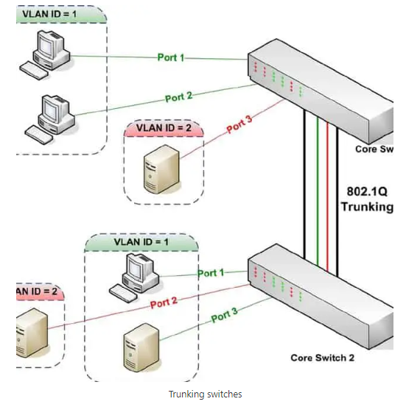
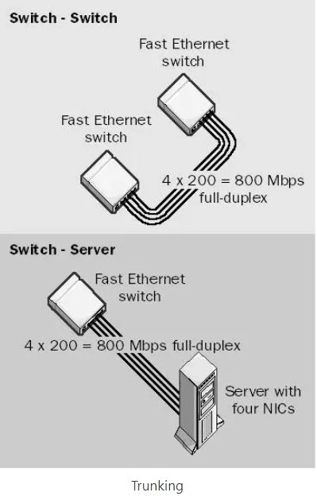

Slide 48
Multiplexing in Trunks
Another method of achieving high bandwidth and simultaneous transmission of several signals is to use a single high capacity link that can carry many signals multiplexed together.
Multiplexing is a method of combining more than one signal over a shared medium.
Multiplexing Techniques
Time division multiplexing (TDM) - In TDM, the users are allowed the total available bandwidth on time sharing basis.
Frequency division multiplexing (FDM) - In FDM, signals of different frequencies are combined for concurrent transmission.

Slide 49
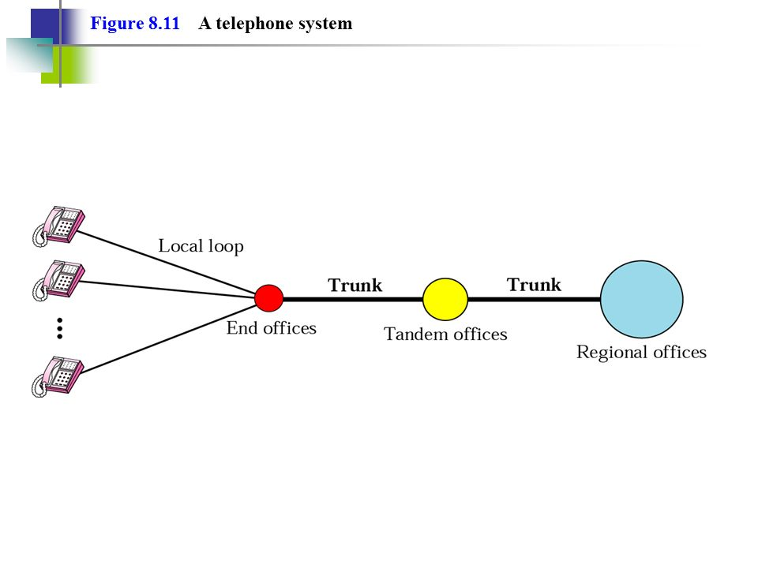
Major Components
The telephone network is made up of three major components:
---------- Local loops, Trunks, and Switching offices.
It has several levels of switching offices such as
---------- End offices, Tandem offices, and Regional offices.

Slide 50
Local Loops
It is a twisted-pair cable that connects the subscriber telephone to the nearest end office or local central office.
The local loop, when used for voice, has a bandwidth of 4000 Hz (4 kHz).
For telephone number associated with each local loop.
The first three digits of a local telephone number define the office
and the next four digits define the local loop number.
Switching Offices
A switching office has switches connects several local loops or trunks and allows a connection between different subscribers

